Slide 1
WEEK 1 PART 2

Slide 2
THE HACK HDL
What is a hardware description language?
Introduction the HDL
Intro to the nand gate using the hdl
How the Stub file works
How the output files,compare files and test files work
How to effectively code using HDL
Cascading effect on how we’re using gates
Notes:
Run a basic file to show how the nand gate works

Slide 3
First program in hdl
Simulation of the nand gate using the HDL
CHIP Nand {
IN a, b;
OUT out;
PARTS:
// Put your code here:
Nand (a=a, b=b, out=out);
}
Run the code on simulator and compare

Slide 4
Coding the Not gate using HDL
Making the and gate using hdl
Go to the stub at Nand2Tetris/projects/01/And.hdl
Nand (a=in, b=in, out=out);
Run the code on the hardware simulator

Slide 5
CHIPs we’re making
Or
And
Xor

Slide 6
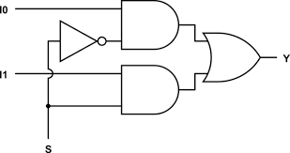
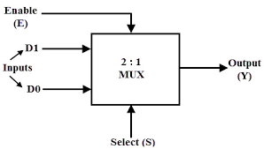
Multiplexers
Used to get 1 input info over other

Slide 7
Multiplexers in HDL
CHIP Mux {
IN a, b, sel;
OUT out;
PARTS:
// Put your code here:
Not (in=sel, out=notsel);
And (a=a, b=notsel, out=outa);
And (a=b, b=sel, out=outb);
Or (a=outa, b=outb, out=out);
}

Slide 8
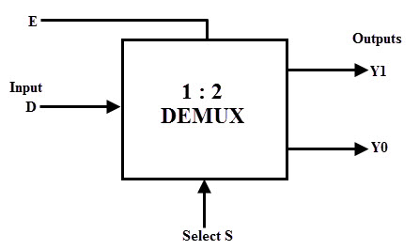
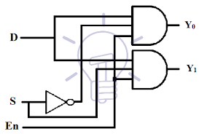
DeMultiplexers
Used to decide which path gets input

Slide 9
DeMultiplexers in HDL
CHIP DMux {
IN in, sel;
OUT a, b;
PARTS:
// Put your code here:
Not (in=sel, out=notsel);
And (a=notsel, b=in, out=a);
And (a=sel, b=in, out=b);
}

Slide 10
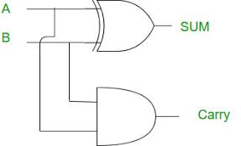
Half Adder
What is a half adder?
How does it add 2 bits?
From truth table to circuit

Slide 11
Half Adder HDL code
CHIP HalfAdder {
IN a, b; // 1-bit inputs
OUT sum, // Right bit of a + b
carry; // Left bit of a + b
PARTS:
// Put you code here:
And (a=a, b=b, out=carry);
Xor (a=a, b=b, out=sum);
}

Slide 12
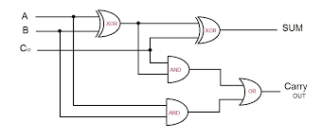
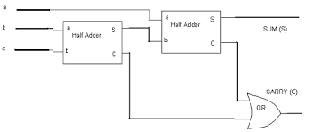
Full adder
What is a Full adder?
How does it add 3 bits
From truth table to circuit
Full adder combining 2 half adders

Slide 13
Full Adder HDL Code
CHIP FullAdder {
IN a, b, c; // 1-bit inputs
OUT sum, // Right bit of a + b + c
carry; // Left bit of a + b + c
PARTS:
// Put you code here:
HalfAdder (a=a, b=b, sum=absum, carry=abcarry);
HalfAdder (a=c, b=absum, sum=sum, carry=abccarry);
Or (a=abccarry, b=abcarry, out=carry);
}

Slide 14
PART 2 DONE!

